Slide 1
WELCOME to 92847
Quantitative Biological Research with Python
CLASS 3 - ELIXIR
Genomic browser
Gene information
RefSeq
Major resources

Slide 2
GENBANK - PRIMARY SEQUENCE DBs
Three collaborating databases
International Nucleotide Sequence Database Collaboration
GenBank (NIH)
DNA Database of Japan (DDBJ)
European Molecular Biology Laboratory (EBI-EMBL) Database

Slide 3
GeneBank The Scale…
Notes:
Primary databases serve as a repository of experimentalist sequences (GenBank).
Derivative databases are sources of edited/curated sequences (RefSeq…reference sequences, UniGene...genes compared to genetic loci on genomes)

Slide 4
EMBL-EBI (important resource)… Release 141 of ENA's assembled/annotated size: ~261 M sequence entries 370 Trilion (10^9) nucleotides. distributed daily Called ENA (European Nucleotide Achieve)
Notes:
Primary databases serve as a repository of experimentalist sequences (GenBank).
Derivative databases are sources of edited/curated sequences (RefSeq…reference sequences, UniGene...genes compared to genetic loci on genomes)

Slide 5
RefSeq Derivative Sequence Database

Slide 6
REFSEQ: DERIVATIVE SEQUENCE DATABASE
Curated transcripts and proteins
Model transcripts and proteins
Assembled Genomic Regions
Chromosome records
Human genome
microbial
organelle
No restriction
in using RefSeq
XM_, XR_, and XP_
NM_, NR_, and NP_
Notes:
Goal= nonredundant set of genes/proteins for each organism represented
Model= comes from analysis of genomic content from organism assembly
Reannotation of microbial genomes, for example.

Slide 7
NCBI REFSEQ
Linked to
PubMed, Nucleotide, Protein, Gene, and Map Viewer, searching with a sequence via BLAST, and downloading from the RefSeq FTP site.
ftp://ftp.ncbi.nih.gov/refseq/release/
Notes:
The first letter in the accession makes a notation of the source database - SRA, EBI, or DDBJ

Slide 8
NCBI REFSEQGENE – clarification
RefSeq mRNA and protein do not providing explicit coordinates for flanking or intronic sequence.
RefSeqGene providing more stable gene-specific genomic sequence for each gene, as well as including upstream and downstream flanking regions.
Notes:
The first letter in the accession makes a notation of the source database - SRA, EBI, or DDBJ

Slide 9
ELEXIR

Slide 10
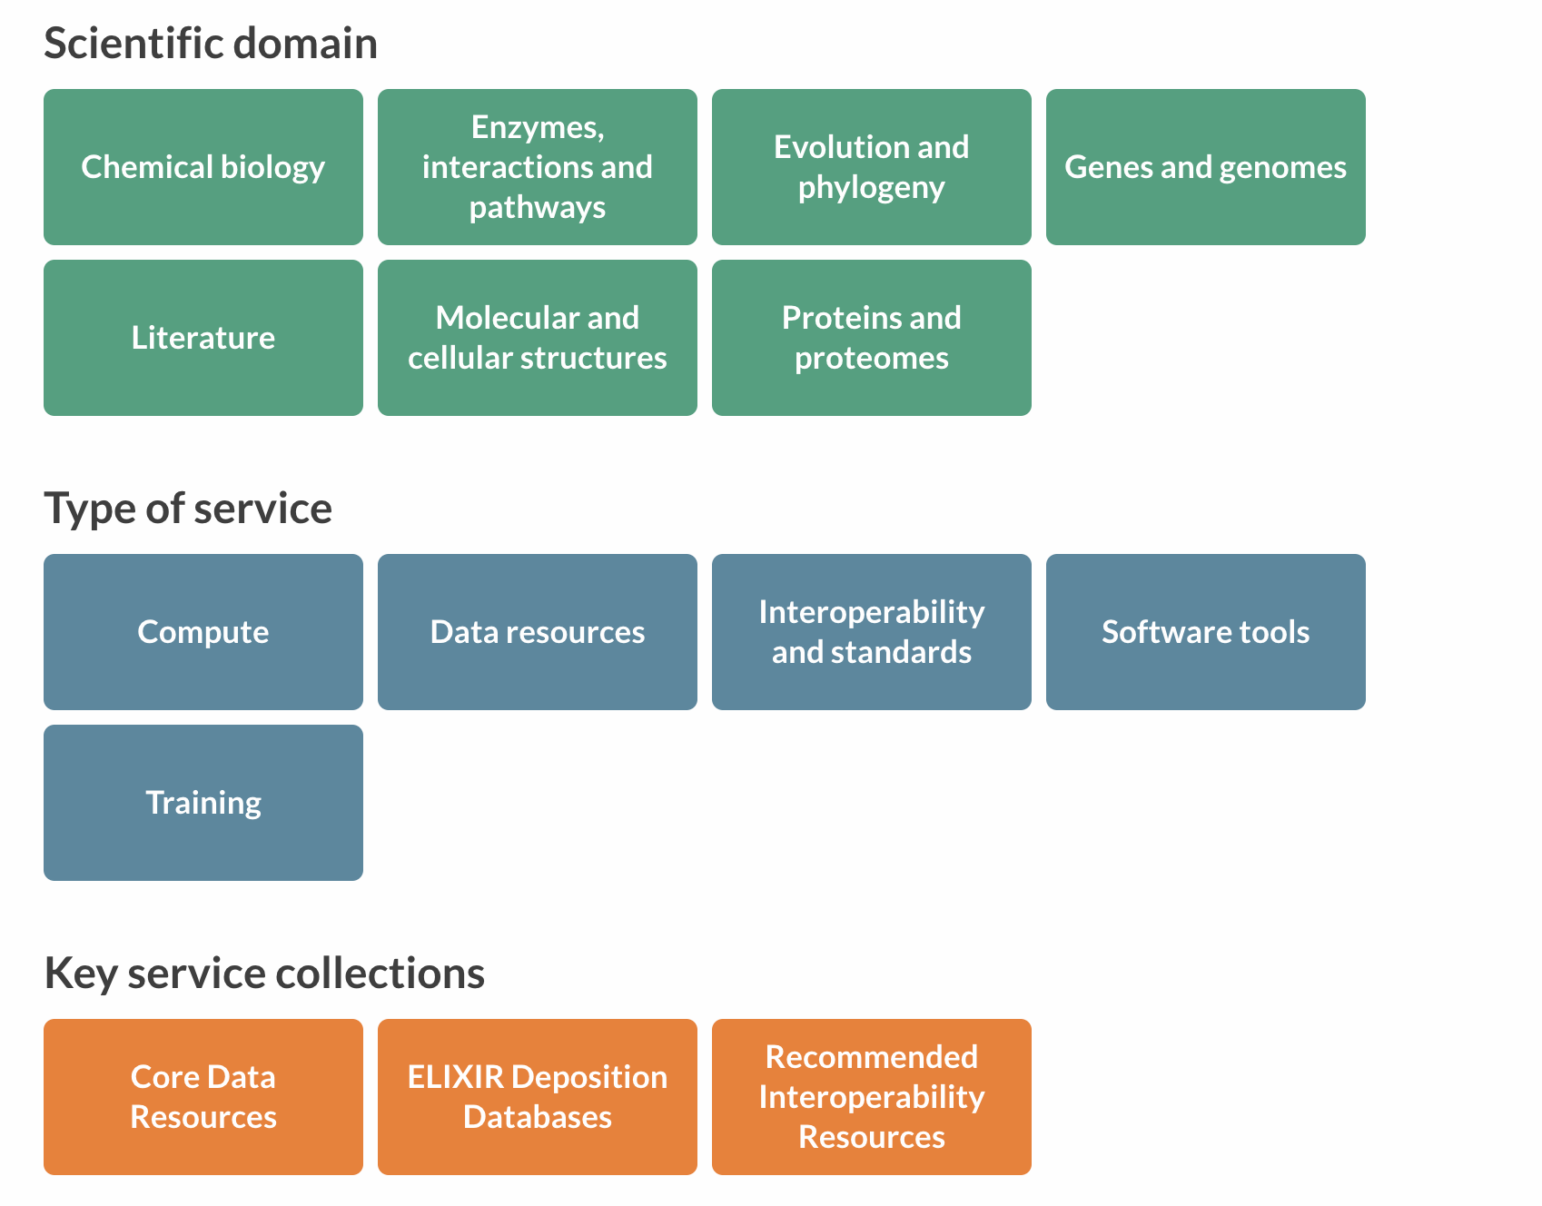
Quality label
Many excellent training
Domain specific
Set of BEST TOOLS

Slide 11
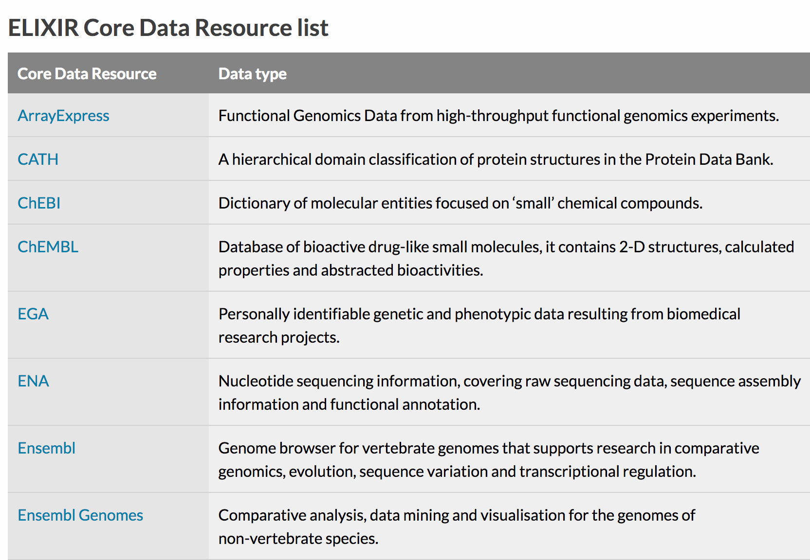
EBI and Europe
Notes:
Primary databases serve as a repository of experimentalist sequences (GenBank).
Derivative databases are sources of edited/curated sequences (RefSeq…reference sequences, UniGene...genes compared to genetic loci on genomes)

Slide 12
Genome Browser

Slide 13
Putting ALL (e.g. RefSeq) in a Genomic Centex
Encyclopedia + ATLAS
GPS coordinates allows you to navigate..
Genome browsers - best navigation within (among) genomes

Slide 14
UCSC – Idea `20 years…
UCSC browser
Ensembl browser ? (not in this class)
Others (organism specific)

Slide 15
Genome browsers Visualization of a gene
Flat files / tab files
>sequence
ATGAAGTTATGGGATGTCGTGGCTGTCTGCCTGGTGCTGCTCCACACCGC
GTCCGCCTTCCCGCTGCCCGCCGGTAAGAGGCCTCCCGAGGCGCCCGCCG
AAGACCGCTCCCTCGGCCGCCGCCGCGCGCCCTTCGCGCTGAGCAGTGAC
TGTAAGAACCGTTCCCTCCCCGCGGGGGGGCCGCCGGCGGACCCCCTCGC
ACCCCCACCCGCAGCCAGCCCCGCACGTACCCCAAGCCAGCCTGATGGCT
GTGTGGCCTACCGACCCGTGGGCAAGGGGTGCGGGTGCTGAAGCCCCCAG
GGGTGCCTGGCTGCCCACTGCTGCCCGCACGCCTGGCCTGAAAGTGACAC
GCGCTGGTTTGCCCAGCACAGAGGGGATGGAATTTTTATGCTGCTCCTTT
AGCATTCTGATGAACAAATATCCTCCCCACCAGCACCACCACCTCAGAAA
Chr5 123.004.678 123.404.678 124.987.012 125.345.112

Slide 16
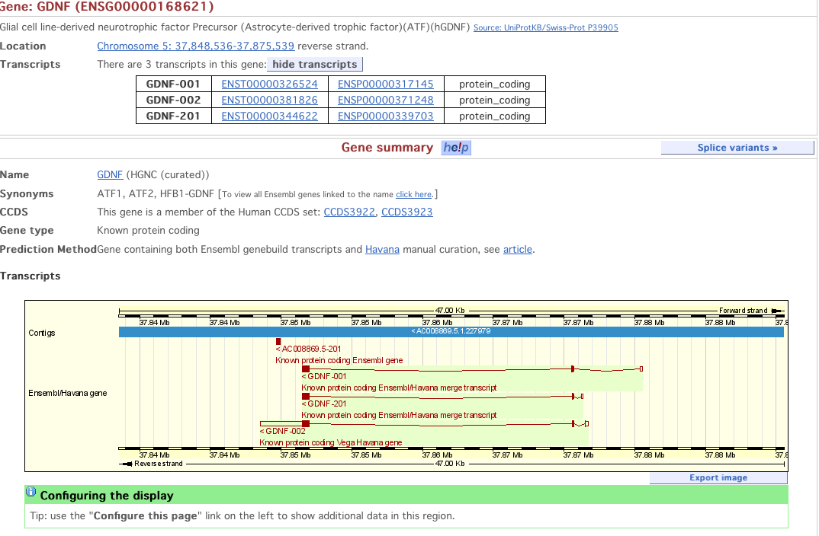
Genome browsers Visualization of a gene (Ensembl)

Slide 17
Ensembl
-which organism (many)
- name of gene (Syt1)
- 5 major sections

Slide 18
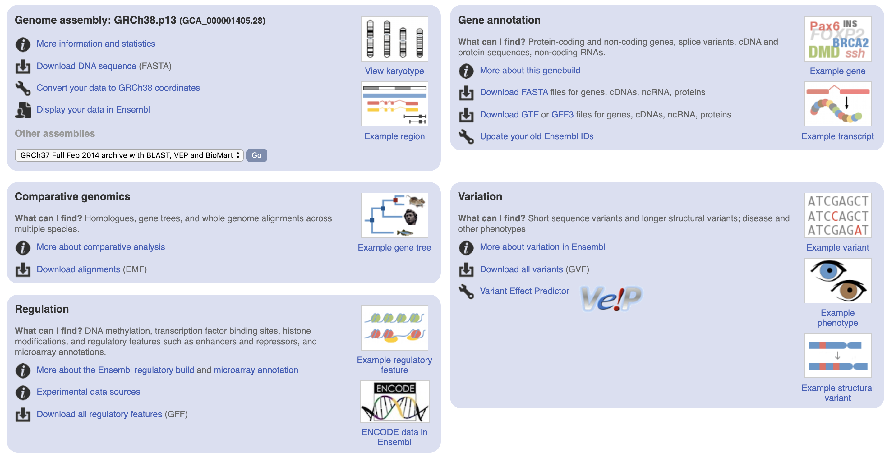

Slide 19
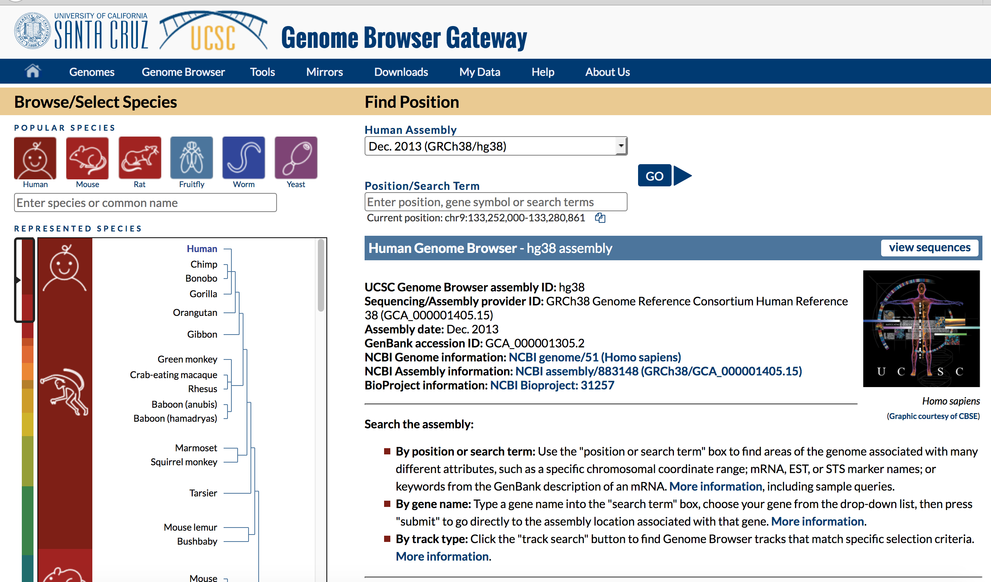
Fully active on 2005 - Developing very fast – See NEWS
http://genome.ucsc.edu

Slide 20
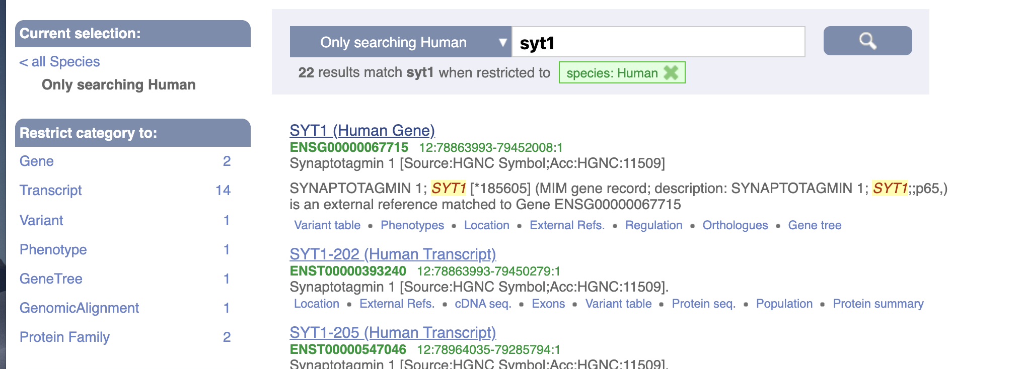
SYT1

Slide 21
SYT1
Be sensitive to
- version Human (GRCh38.p13)
- transcript – often there are many… seek REfSeq (default)
TSL-1: Transcript Support Level 1,
when transcripts are supported by at least one non-suspect mRNA.
P3 - APPRIS candidate principal isoform (earliest CCDS).

Slide 22
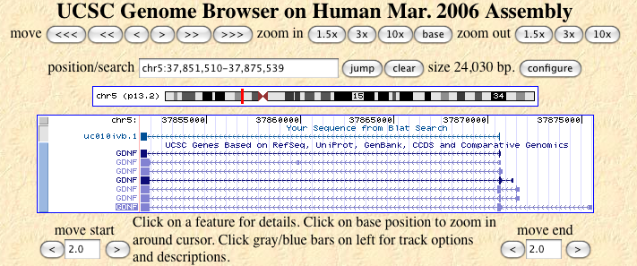
Genome browsers Visualization of a gene (UCSC)
Exon Intron UTR

Slide 23
Genome browsers (compare)
UCSC genome browser
http://genome.ucsc.edu/
Easy to use
Often updates, but not as often as Ensembl
upload of personal tracks
Ensembl browser
http://www.ensembl.org/index.html
Less easy to use
Maintained/updated by several people

Slide 24
UCSC genome browser Basic functionalities
Finding a gene
by name
by sequence
Gene structure
Sequence orthologues
Single Nucleotide Polymorphisms (SNPs)
Gene Sorter - sort according to expression, homology ...
Custom tracks

Slide 25
Organization of genomic data…
sequence
Genome backbone: base position number
chromosome band
sts sites
gap locations
Links out to
more data
known genes
Annotation Tracks
predicted genes
microarray/expression data
evolutionary conservation
SNPs
repeated regions
more…

Slide 26
Organization of Genomic Data
sequence
Reference genome: base position number
chromosome band
gap locations
Annotation Tracks
known genes
Links out to
more data
predicted genes
phenotype and disease
enhancer/promoter data
microarray/expression data
evolutionary conservation
SNPs and structural variation
repeated regions
more…
26
Notes:
26
So—there are tremendous volumes of data available; and many places to try to find it. The UCSC Genome Browser is a great resource because it organizes this material in one place. It uses the sequence of the genome—the official “reference” sequence of the Human Genome Project, or the official reference genome of other species—and combines this data with all kinds of other useful and important biological information, such as chromosome banding patterns, known genes, gene predictions, phenotype and disease information, enhancer and promoter data, expression data, comparative genomics and evolutionary conservation, SNPs and other variations, and so on.
As I illustrate in this conceptual diagram, the data is organized along the official genomic sequence reference coordinates. The other data types are referred to as “Annotation Tracks” and are aligned on the genomic sequence framework. These tracks provide additional information about any given genomic region of interest.
All of this data is aligned in one place so you can quickly find new information, and context, about regions important for your work. In addition, all the data links out to other databases, web sites, and literature so you can go as deep as you want into any specific topic in which you may be interested.

Slide 27
The Genome Browser Gateway
Few points to note:
A very ‘flexible’ gateway
A Gateway to search by:
Gene names, symbols
Chromosome number: chr7, or region: chr11:1038475-1075482
Keywords: kinase, receptor
IDs: NP, NM, OMIM, and more

Slide 28
The Genome Browser Gateway
Few points to note:
A very ‘flexible’ visualization
A Visualization and resolution by:
Colors
Resolution
Pixles

Slide 29
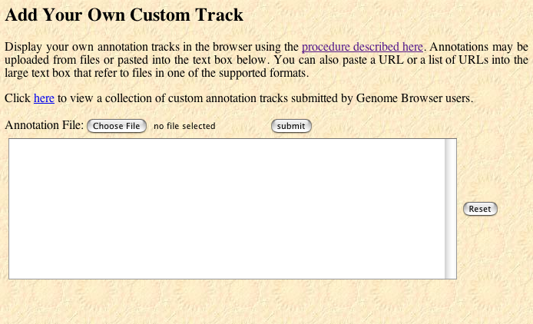
Custom Tracks: Upload File from Computer
Click to browse your computer to find file

Slide 30
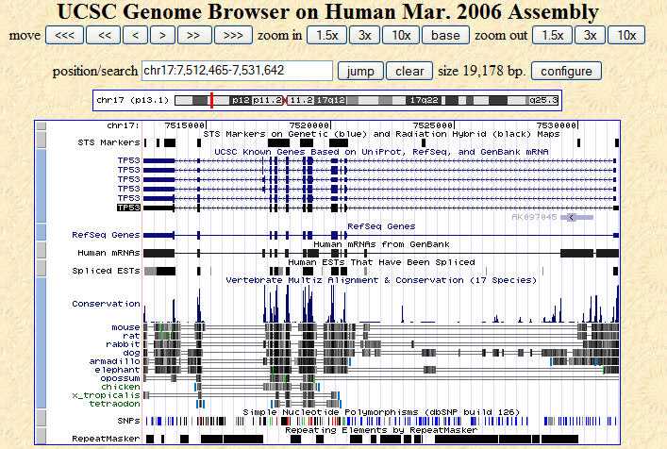
Sample Genome Viewer image, TP53 region
base position
STS markers
Known genes
RefSeq genes
GenBank seqs
17 species compared
single species compared
SNPs
repeats

Slide 31
Visual Cues on the Genome Browser
Tick marks; a single location (STS, SNP)
exon
< < <
exon
<
exon
< < < <
ex
3' UTR
5' UTR
Intron, and direction of transcription <<< or >>>
Track colors may have meaning—for example, Known Gene track:
If there is a corresponding PDB entry, = black
If there is a corresponding NCBI Reviewed seq, = dark blue
If there is a corresponding NCBI Provisional seq, = light blue
For some tracks, the height of a bar is increased likelihood
of an evolutionary relationship (conservation track)

Slide 32
The Genome Browser Gateway
Few points to note:
A very ‘flexible’ dataset connections
Regulation
In-situ information
Developments
Population view
YOUR OWN DATA SETS

Slide 33
The Genome Browser Gateway
Few points to note:
An organized topics for genomics
You dynamically choose to focus on any of these sections
ENCODE provides all collected data

Slide 34
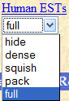


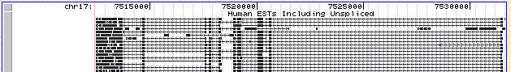

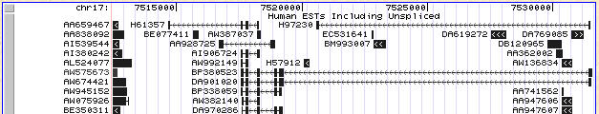
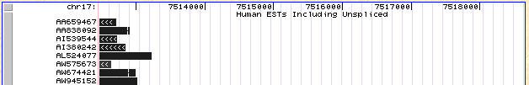
Annotation Track options, defined
Hide: removes a track from view
Dense: all items collapsed into a single line
Squish: each item = separate line, but 50% height + packed
Pack: each item separate, but efficiently stacked (full height)
Full: each item on separate line

Slide 35
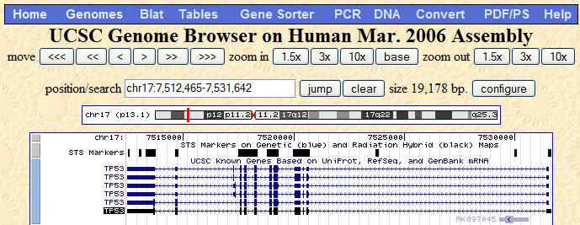
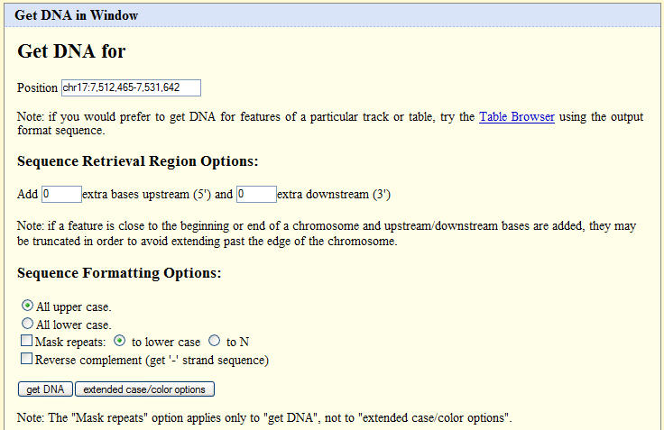
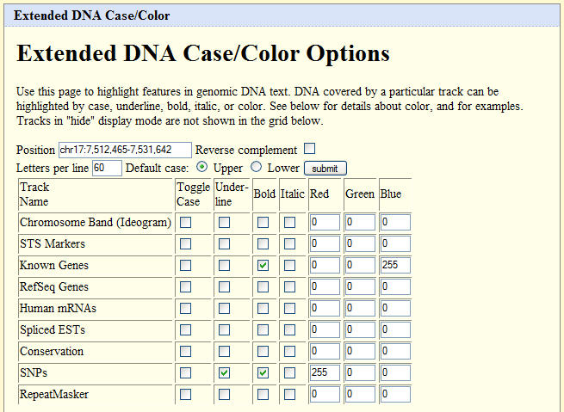
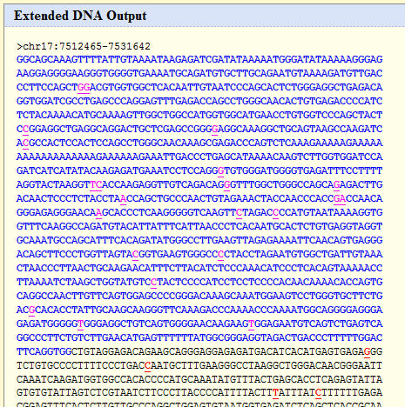
Get DNA, with Extended Case/Color Options
Use the DNA link at the top
Plain or Extended options
Change colors, fonts, etc.

Slide 36
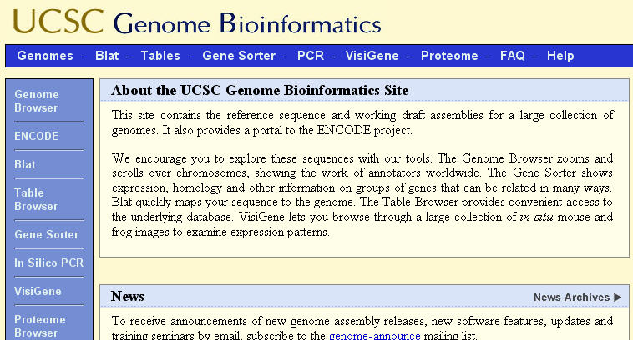
Accessing the BLAT tool
BLAT = BLAST-like Alignment Tool
Rapid searches by INDEXING the entire genome
Works best with high similarity matches
Kent, WJ. Genome Res. 2002. 12:656

Slide 37
The Genome Browser Gateway
Few points to note:
Always you can go back to DEFAULT viewer
The default viewer is a good starting point for a browser..
There are some simple rules…

Slide 38
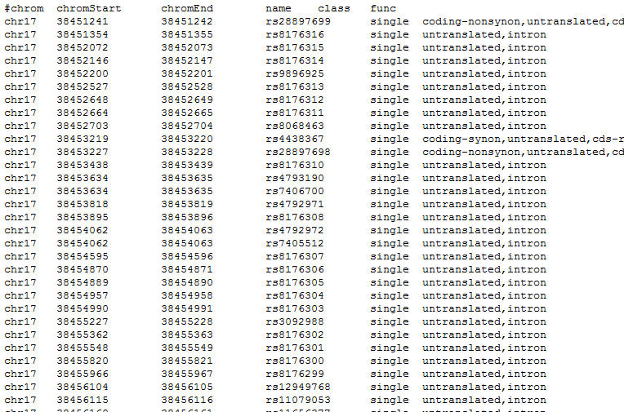
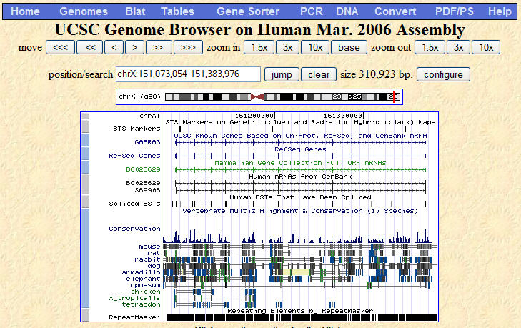
Genome Browser Database
visualize
search & download
Underlying
Database
(MySQL)
Primary table: positions, names, etc.
Auxiliary table: related data
Notes:
The Genome Browser database is comprised of “tables” of data. Some tables are primary and contain positional information. One example is “knowngene” table which includes data such as chromosomal position, gene name, exon and intron sizes and the like.
Other tables include ‘auxiliary’ types of data. Some have positional information and others do not, like the example here that relates knowngene IDs to the corresponding Ensembl gene IDs.
These tables of data comprise the database.
The UCSC Genome Browser is a great way to visualize this genomic data, in context with many data types. Each annotation track in the Genome Browser draws from these “tables” of data in which to build that graphical view of the annotation track and the details pages you see. Each annotation track is based on a table that contains genomic positions, item names, and sometimes additional information. The Genome Browser queries this main table when generating the graphical display. Some tracks also have one or more auxiliary tables, related to the main table by a shared column of data, that contain even more detailed information about the track's items.
The Table Browser allows you to access these same tables of data directly, filtering, manipulating and downloading the data in a very customized and flexible manner not possible with the Genome Browser. For example, you may want a list of all the SNPs in a given gene, as in the sample we show here, Or maybe you want to know what all the known genes are on Chromosome 21. You could also do a narrow search of only those SNPs that are non-synonymous coding variations found in disease genes. The possibilities of customized searching and data retrieval are nearly endless with the Table Browser..

Slide 39
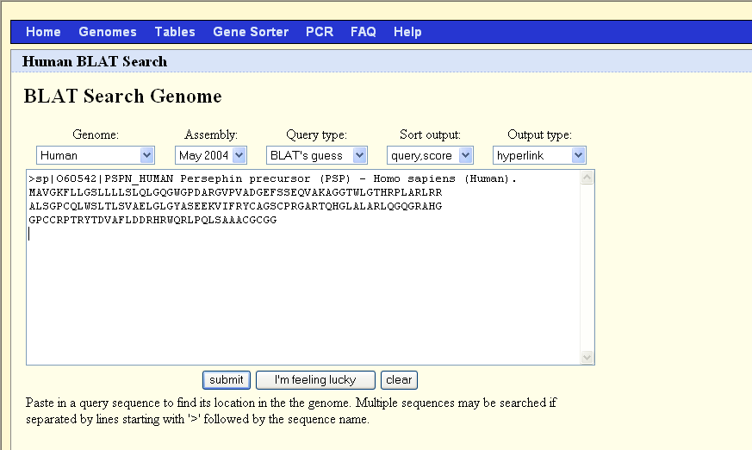
BLAT genome Browser
Using a protein or DNA sequence

Slide 40
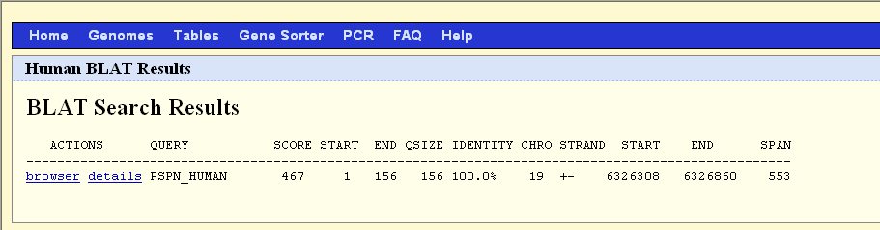
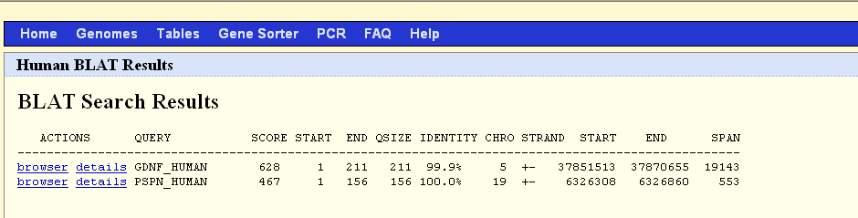
Blat genome Browser

Slide 41
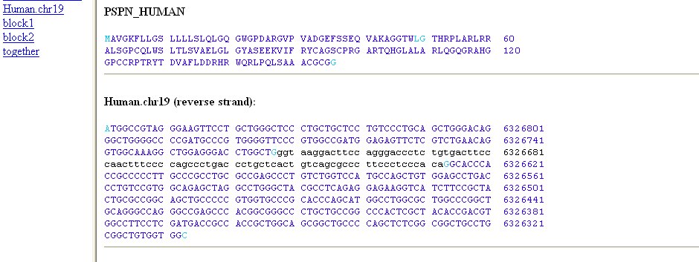
BLAT genome Browser ”Details”
Donor site | Acceptor site
exon... . G | GT ...intron ...AG | exon...

Slide 42
Blat genome Browser

Slide 43
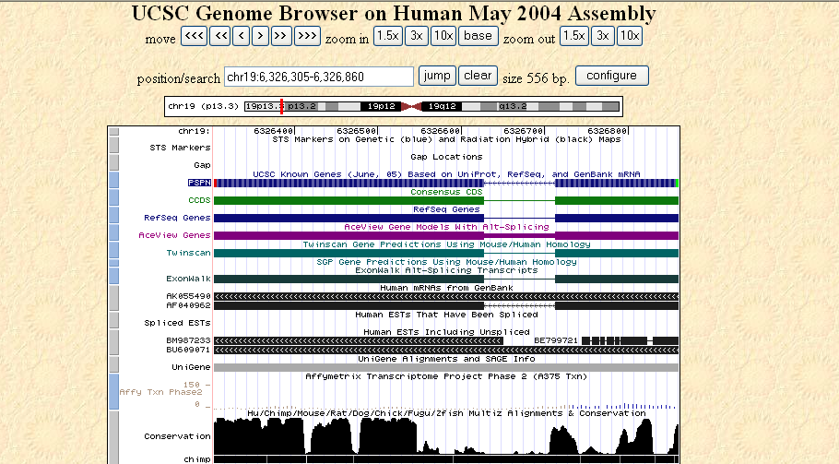
BLAT genome Browser ”Browser”
Base,
Center &
Zoom
Known genes
Predictions
RNA
EST
Expression
Conservation

Slide 44
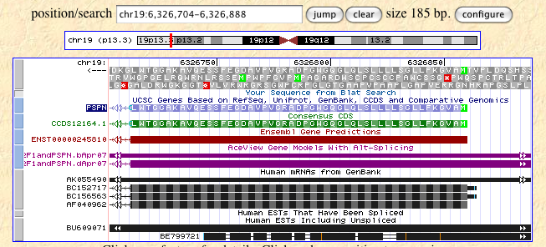
BLAT genome Browser Center & zoom

Slide 45
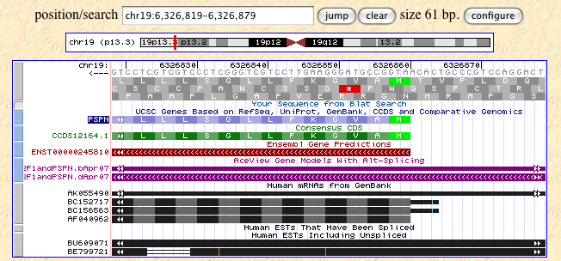
BLAT genome Browser Center & zoom
Selected number of tracks
Forward/reverse direction

Slide 46
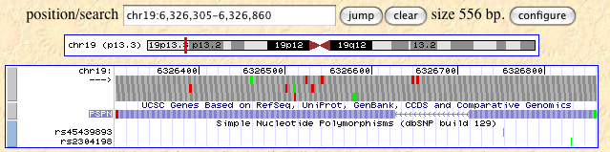
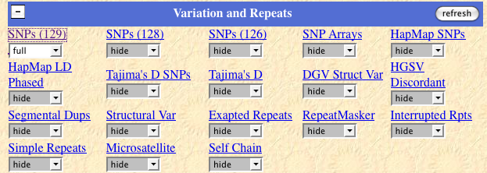
SNPs

Slide 47
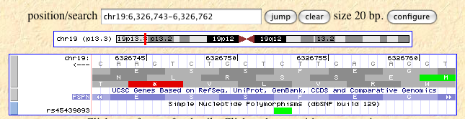
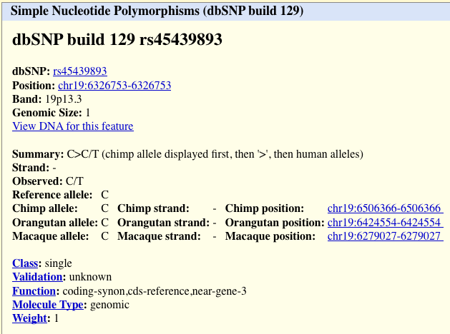
SNPs

Slide 48
Custom tracks
Upload your personal data
Share data with colleagues
Data need to be related to a reference organism

Slide 49
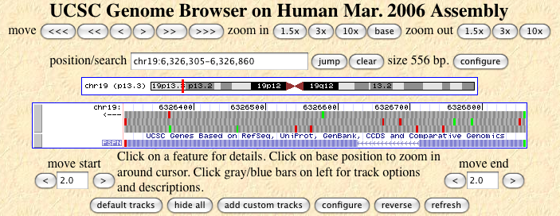
Custom tracks

